Slide 1
CAPSTONE PROJECT- 4
NETFLIX MOVIES AND TV SHOWS CLUSTERING
Presented by:
Minal Kharbade
Deveshya Gupta

Slide 2
CONTENT
Problem Statement
Data Description
Exploratory Data Analysis
Data processing
Clustering Methods
Clustering Models
Conclusion

Slide 3
PROBLEM STATEMENT
Dataset consist of TV shows and movies available on Netflix as of 2019.
In 2018 they released a interesting report which shows that number of TV shows on netflix has nearly tripled since 2010.
The streaming services no of movies has decreased by more than 2000 titles since 2010 , while its no of Tv shows has nearly tripled. It will be interesting to explore what all the insights can be obtained from the same dataset.
In this project we are required to do
1. Exploratory Data Analysis
2. Understanding what type of content is available in different countries
3. Is Netflix has increasingly focusing on TV rather than movies in recent years?
4. Clustering similar content by matching text based features

Slide 4
DATA DESCRIPTION
show_id : Unique ID for every Movie / Tv Show
type : Identifier - A Movie or TV Show
title : Title of the Movie / Tv Show
director : Director of the Movie
cast : Actors involved in the movie / show
country : Country where the movie / show was produced
date_added : Date it was added on Netflix
release_year : Actual Release year of the movie / show
rating : TV Rating of the movie / show
duration : Total Duration - in minutes or number of seasons
listed_in : Genere
description: The Summary description

Slide 5
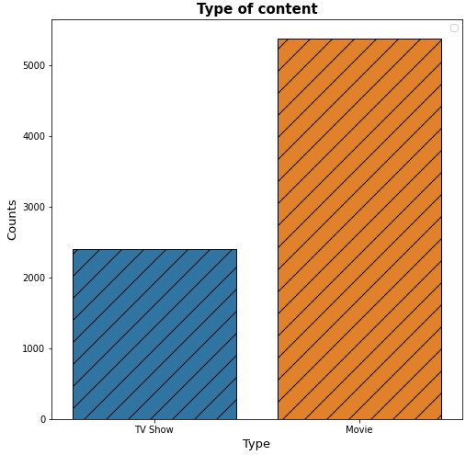
EXPLORATORY DATA ANALYSIS( EDA)
Analysing what type of content present in Netflix:
From this chart it is clearly visible that movies are more present in Netflix.

Slide 6
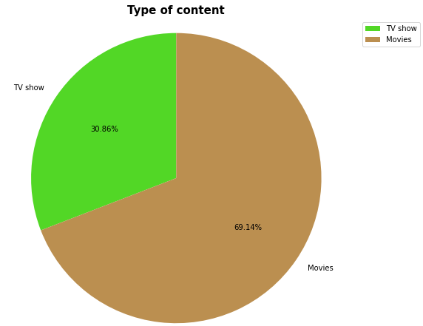
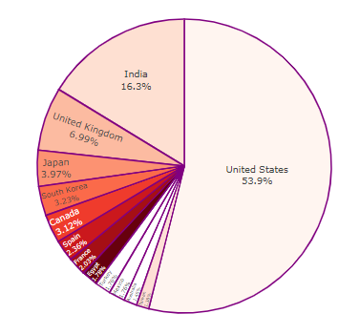
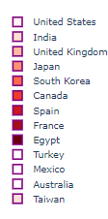
Different type of content present in Netflix and different countries:

Slide 7
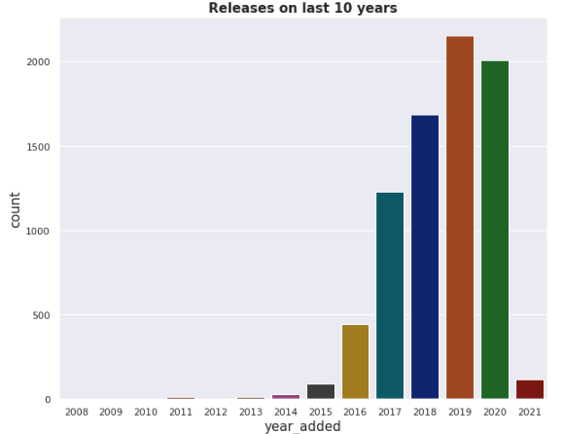
Year wise Analysis:

Slide 8
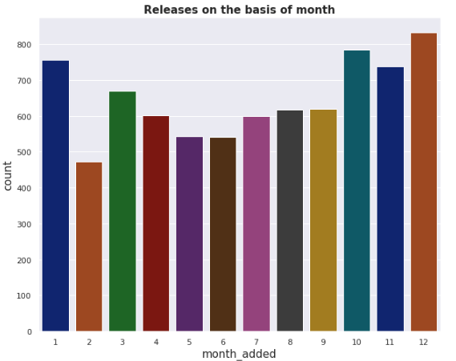
Month wise Analysis:

Slide 9
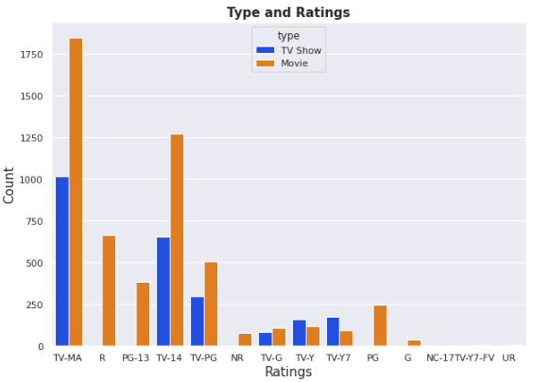
Type and Rating:

Slide 10
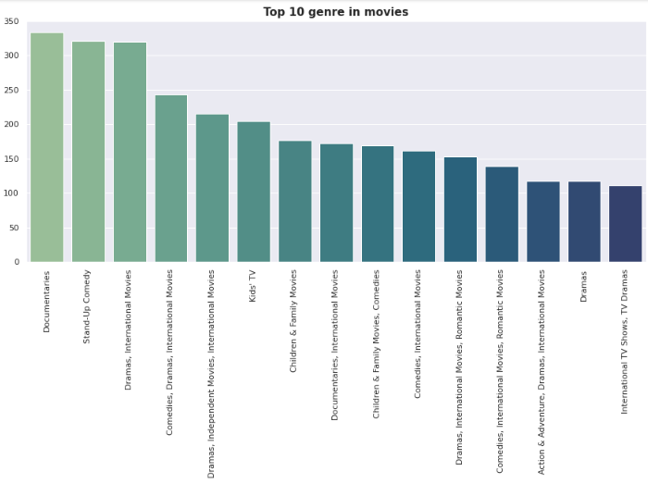
Top 10 genre in Movies:

Slide 11
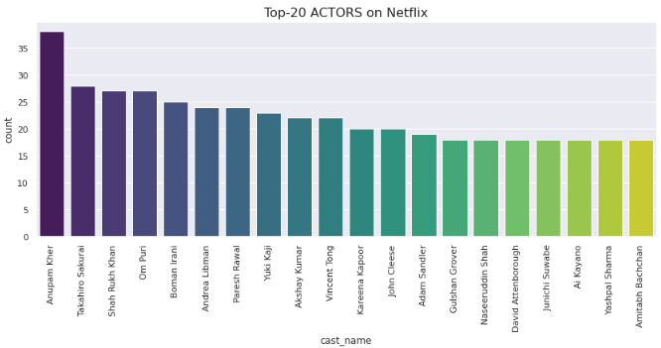
Top 20 actors on Netflix:

Slide 12
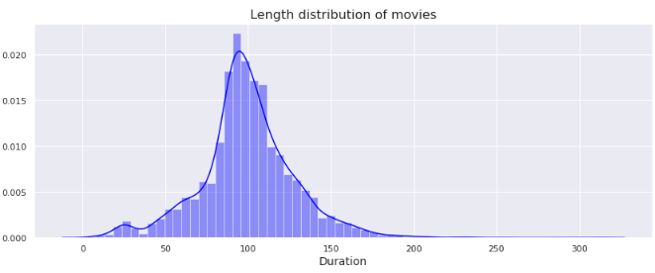
Length distribution of movies:

Slide 13
Topic Modeling:
Latent Semantic Analysis (LSA)
LSA stands for latent semantic analysis is one of the foundational technique used in topic modeling .Latent semantic analysis is a natural language processing method that analyzes relationship between set of documents and term contain within. The core idea is to take matrix of documents and term and try to decompose it into separate into two matrices
Document topic matrix
Document term matrix

Slide 14
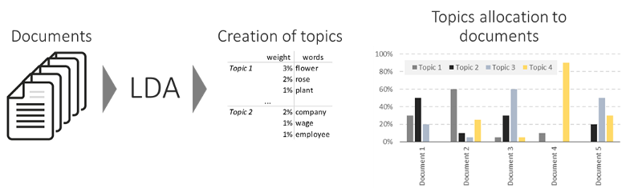
Latent Dirichlet Allocation (LDA)
LDA is general probabilistic model that assumes each topic is mixture over and underlying set of words and each document is a mixture of over set of probabilities.

Slide 15
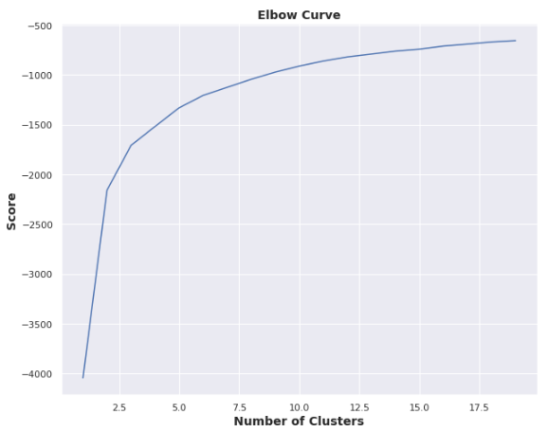
K-mean Clustering:
Elbow method:

Slide 16
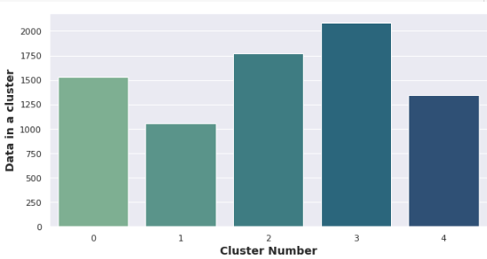

Slide 17
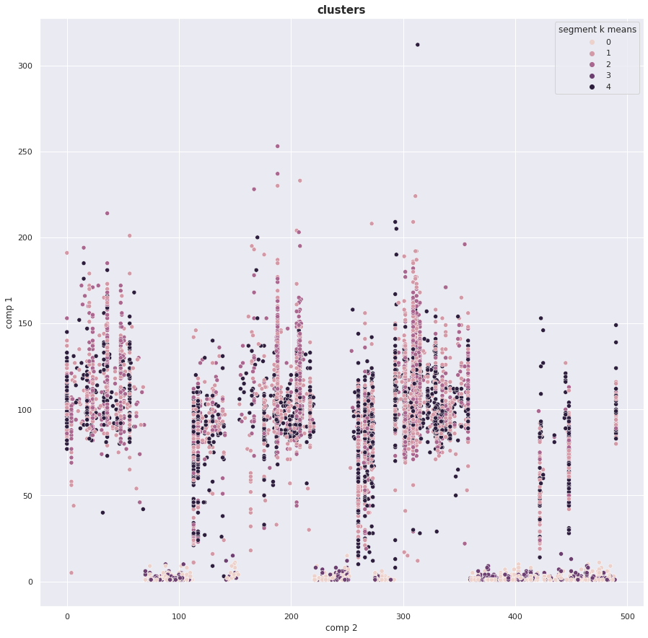

Slide 18
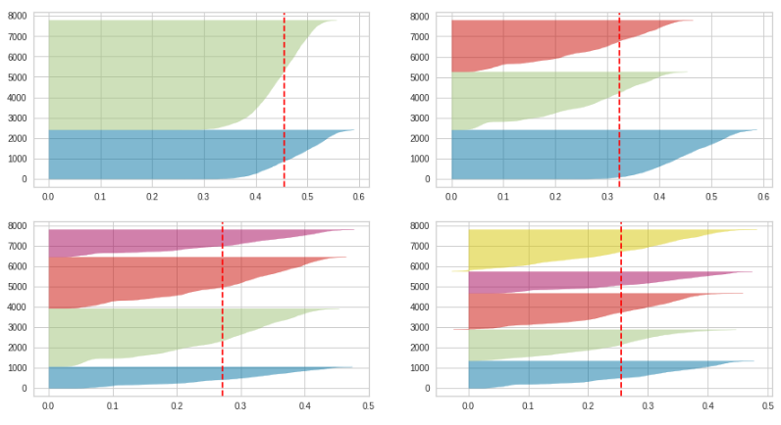
Silhouette method:

Slide 19
CONCLUSION
From the analysis we can say that there are 70% movies and 30% TV shows on Netflix.
US has 54% content on Netflix and then followed by india with 16%.
LSA and LDA has sorted much more similar titles in a group of genre.
Recommendation system works well with description column.
After applying k-means clustering the optimal value of no of cluster is 5.
Silhouette score for a set of sample data points is used to measure how dense and well separated cluster are.

Slide 20
THANK YOU

